Slide 1

Digit recognition
Final Presentation
Presented by Daria Morkis, Alex Kohlmann and Karolina Walach
Supervisor: Dr. Leonid Kostrykin, PD Dr. Karl Rohr
Tutor: Hannah Winter

Slide 2
What does our code include?
PCA
Self-implemented KNN
KDTree and KNeighborsClassifier
confusion matrix and classification report
SVM
CNN

Slide 3






Used Libraries

Slide 4
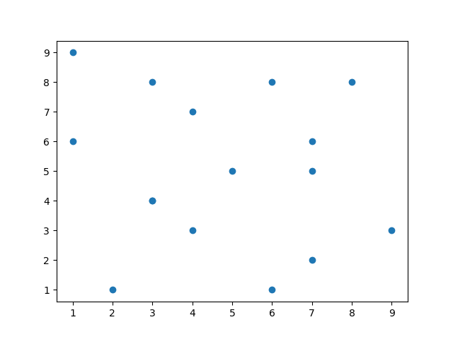
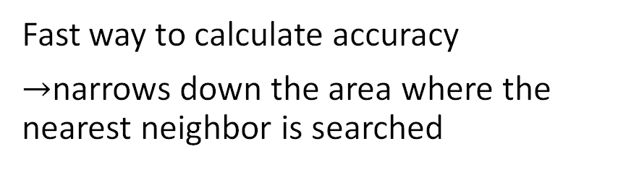
KD Tree
Fast way to calculate accuracy
$→$narrows down the area where the nearest neighbor is searched

Slide 5
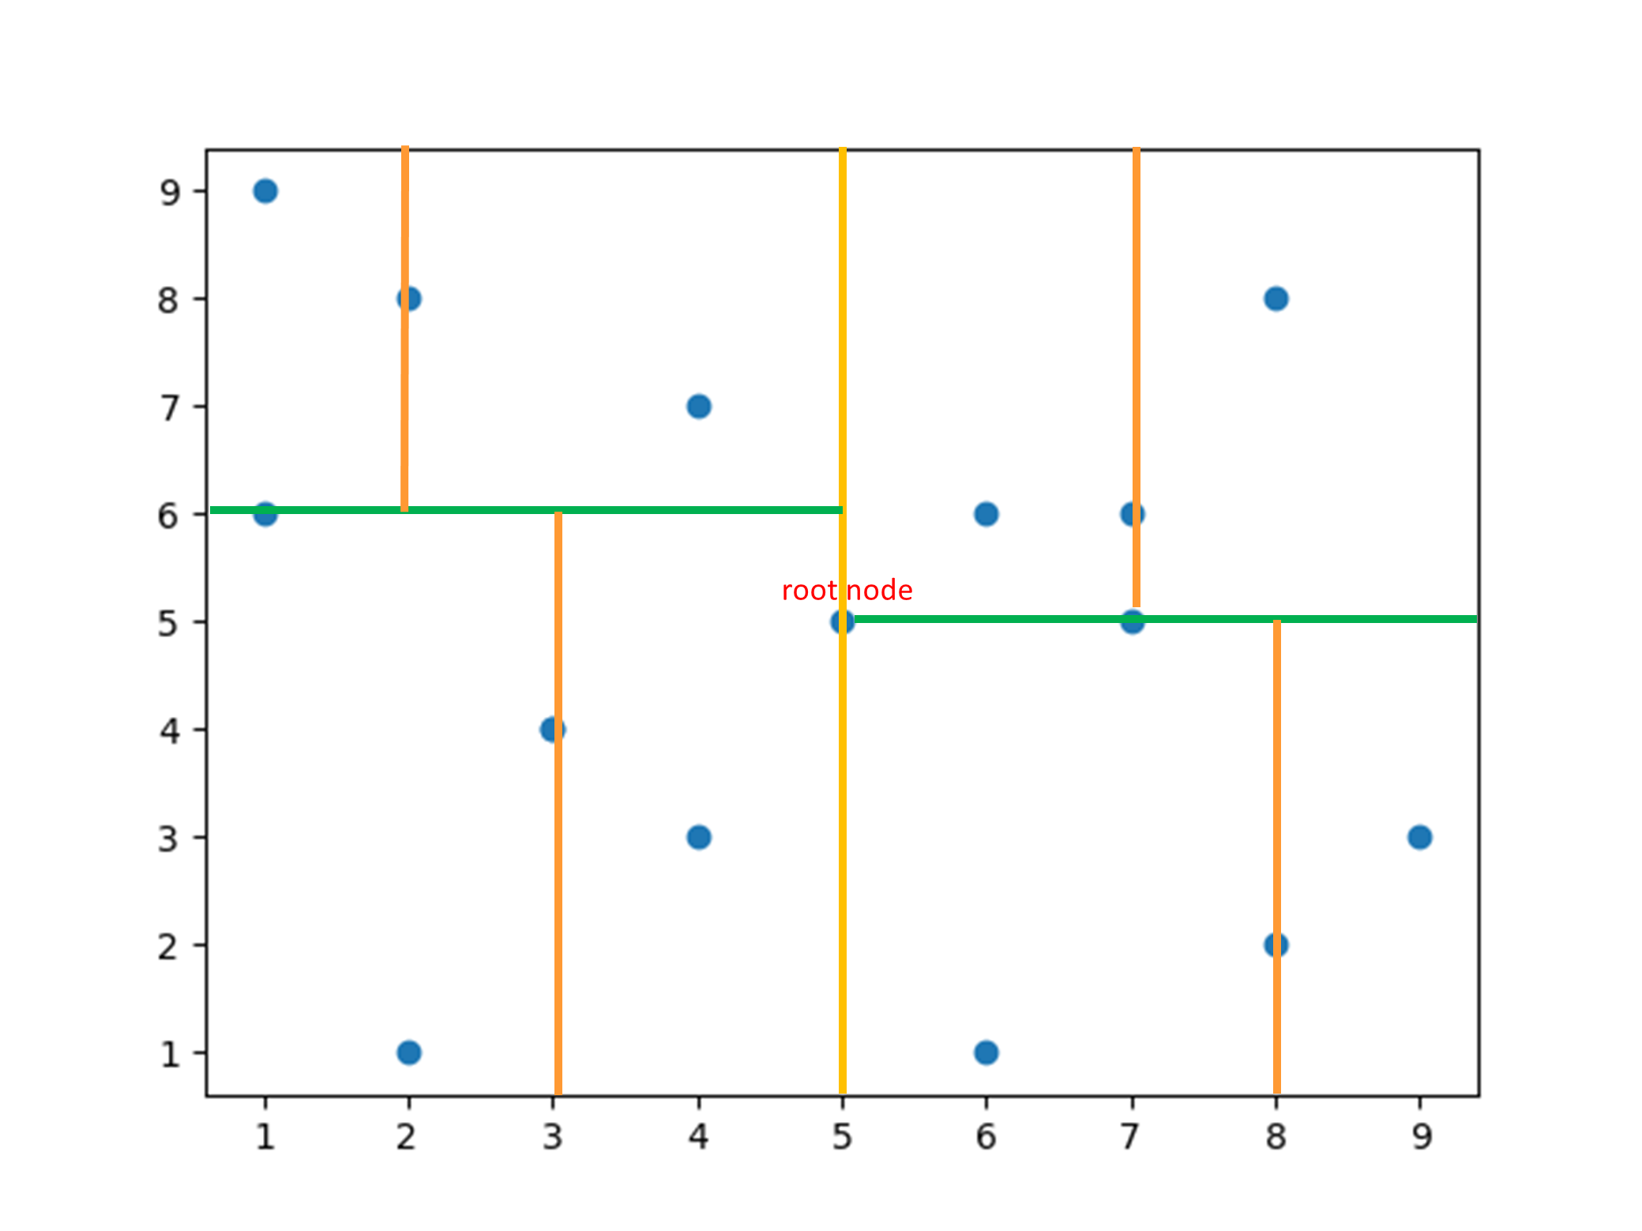
KD Tree

Slide 6
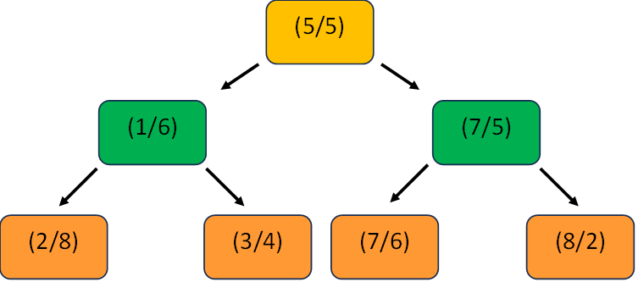
KD Tree

Slide 7
KNeighborsClassifier
sklearn.neighbors.KNeighborsClassifier(n_neighbors=5, weights='uniform', algorithm='auto', leaf_size=30, p=2, metric='minkowski', metric_params=None, n_jobs=None)

Slide 8
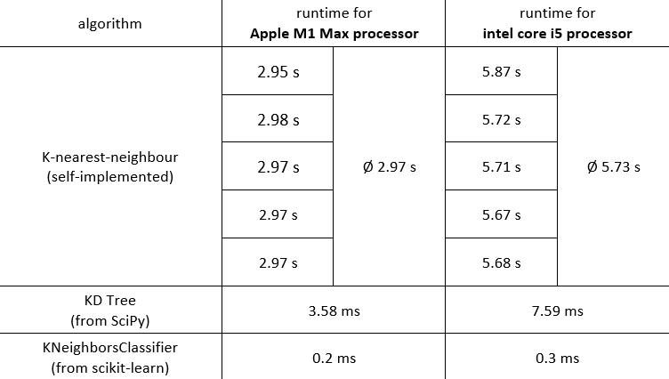
Runtime of algorithms

Slide 9
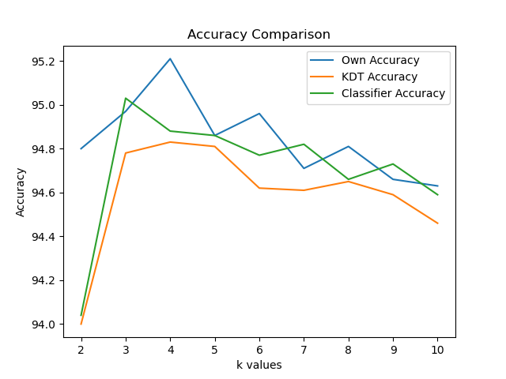
KNN vs. KD-Tree vs. KNeighborsClassifier
Best k-value at pc=330
KNN: k=4 with 95.21%
KD-Tree: k=4 with 94.83%
Classifier: k=3 with 95.03%
Why is k relatively small?
→ Differences of the first euclidean distances are small in ascending order

Slide 10
Why are the accuracies different?
Possible explanations:
Different rounding of euclidean distances
Different selection of nearest neighbor
Different selection of most common label (when k even)

Slide 11
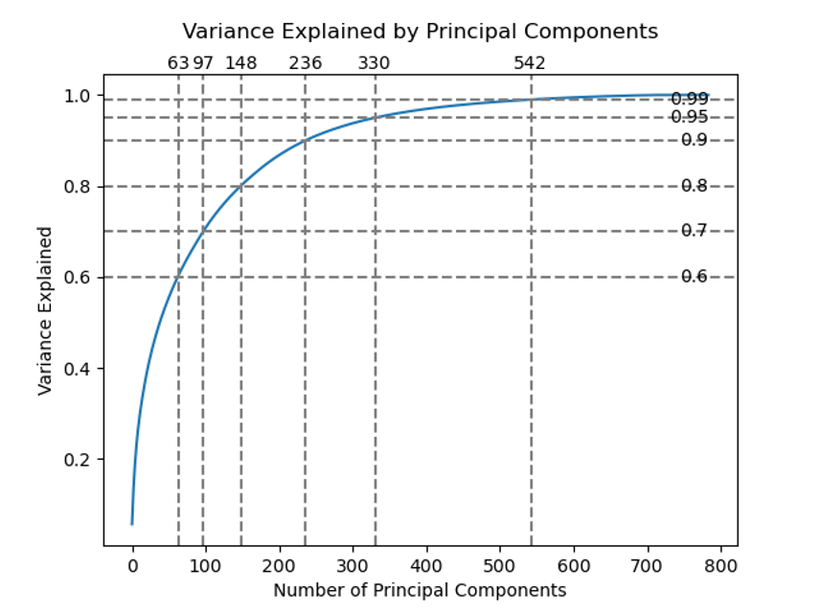
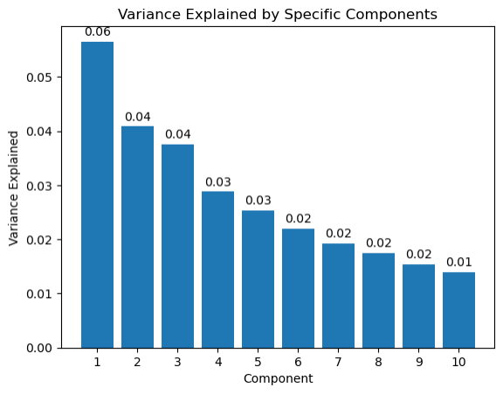
Principal components

Slide 12
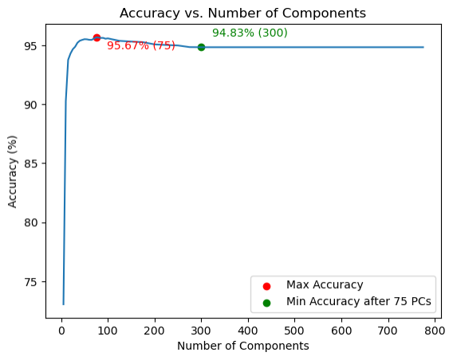
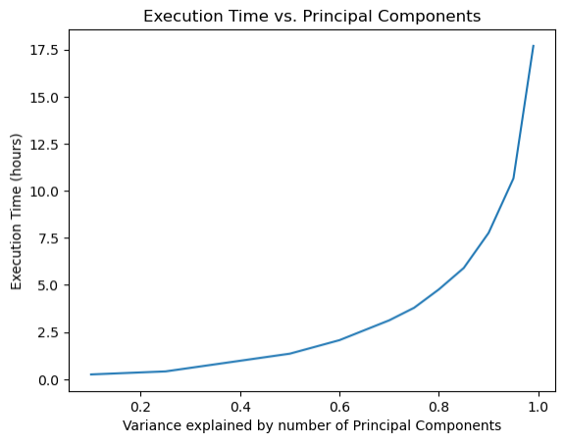
Execution time and accuracies for different numbers of PCs
Decrease in accuracy: Why?

Slide 13
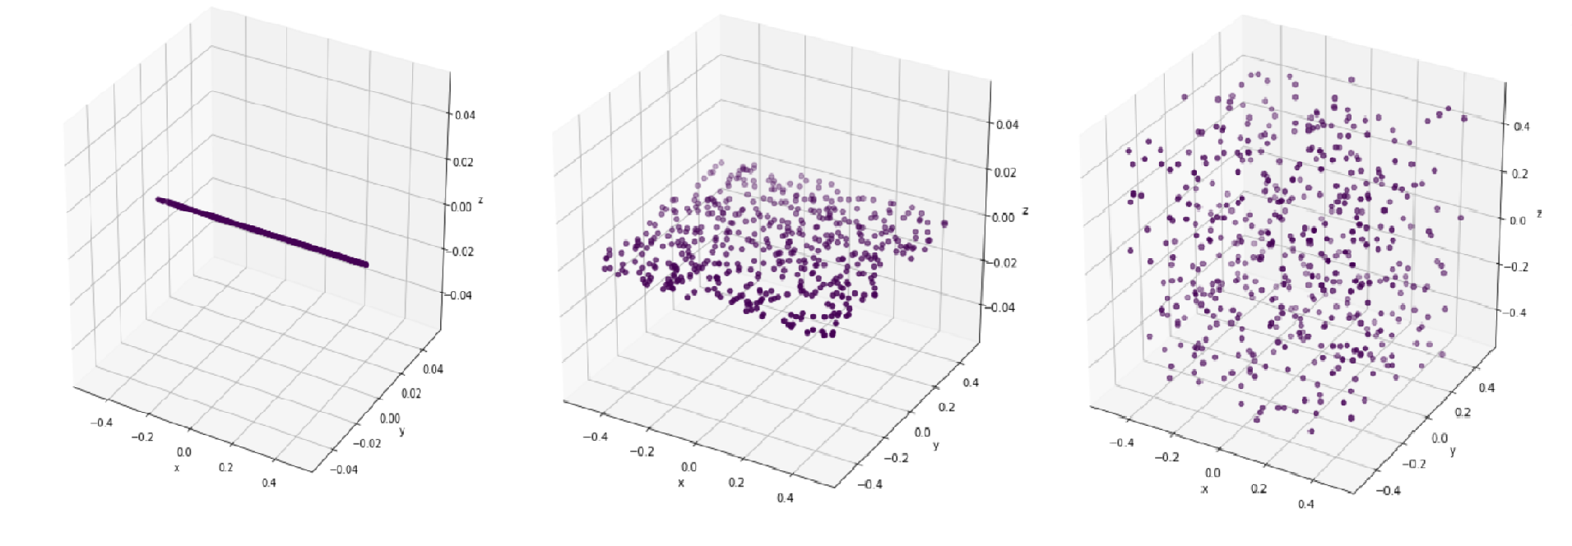
Curse of dimensionality
More PCs -> more information
More possibilities to differ from one another
increase of distance between datapoints
Finding k-nearest neighbors becomes more difficult
Increase of dimensions

Slide 14
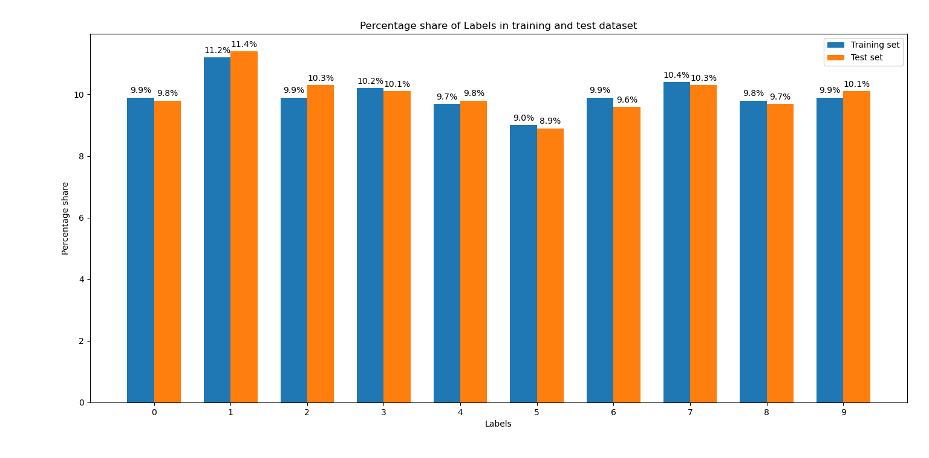
Error Analysis – balanced or imbalanced?

Slide 15
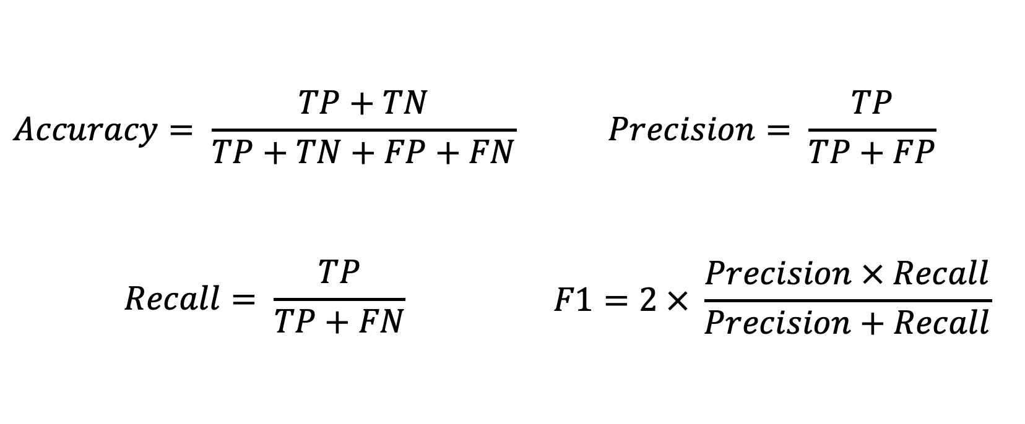
Error Analysis – classification report

Slide 16
Error Analysis – classification report
digit | precision | recall | f1-score | support
0 | 0.96 | 0.99 | 0.98 | 980
1 | 0.97 | 0.99 | 0.99 | 1135
2 | 0.96 | 0.96 | 0.96 | 1032
3 | 0.94 | 0.96 | 0.95 | 1010
4 | 0.96 | 0.96 | 0.96 | 982
5 | 0.94 | 0.95 | 0.95 | 892
6 | 0.97 | 0.97 | 0.97 | 958
7 | 0.95 | 0.94 | 0.95 | 1028
8 | 0.95 | 0.94 | 0.94 | 974
9 | 0.95 | 0.93 | 0.93 | 1009
accuracy |  |  | 0.96 | 10000
macro avg | 0.96 | 0.96 | 0.96 | 10000
weighted avg | 0.96 | 0.96 | 0.96 | 10000

Slide 17
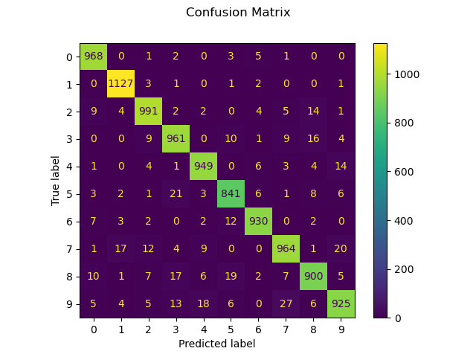
Error Analysis – confusion matrix
For k = 4 and variance = 0.64 Accuracy = 95.89%

Slide 18
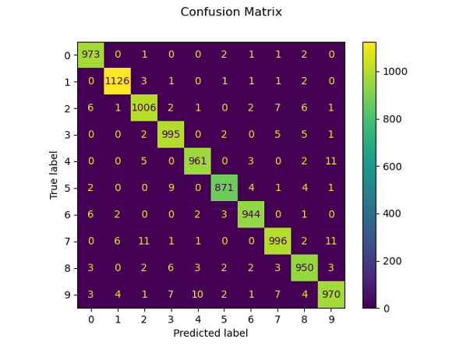
Improvements – SVM
Accuracy = 97.92%

Slide 19
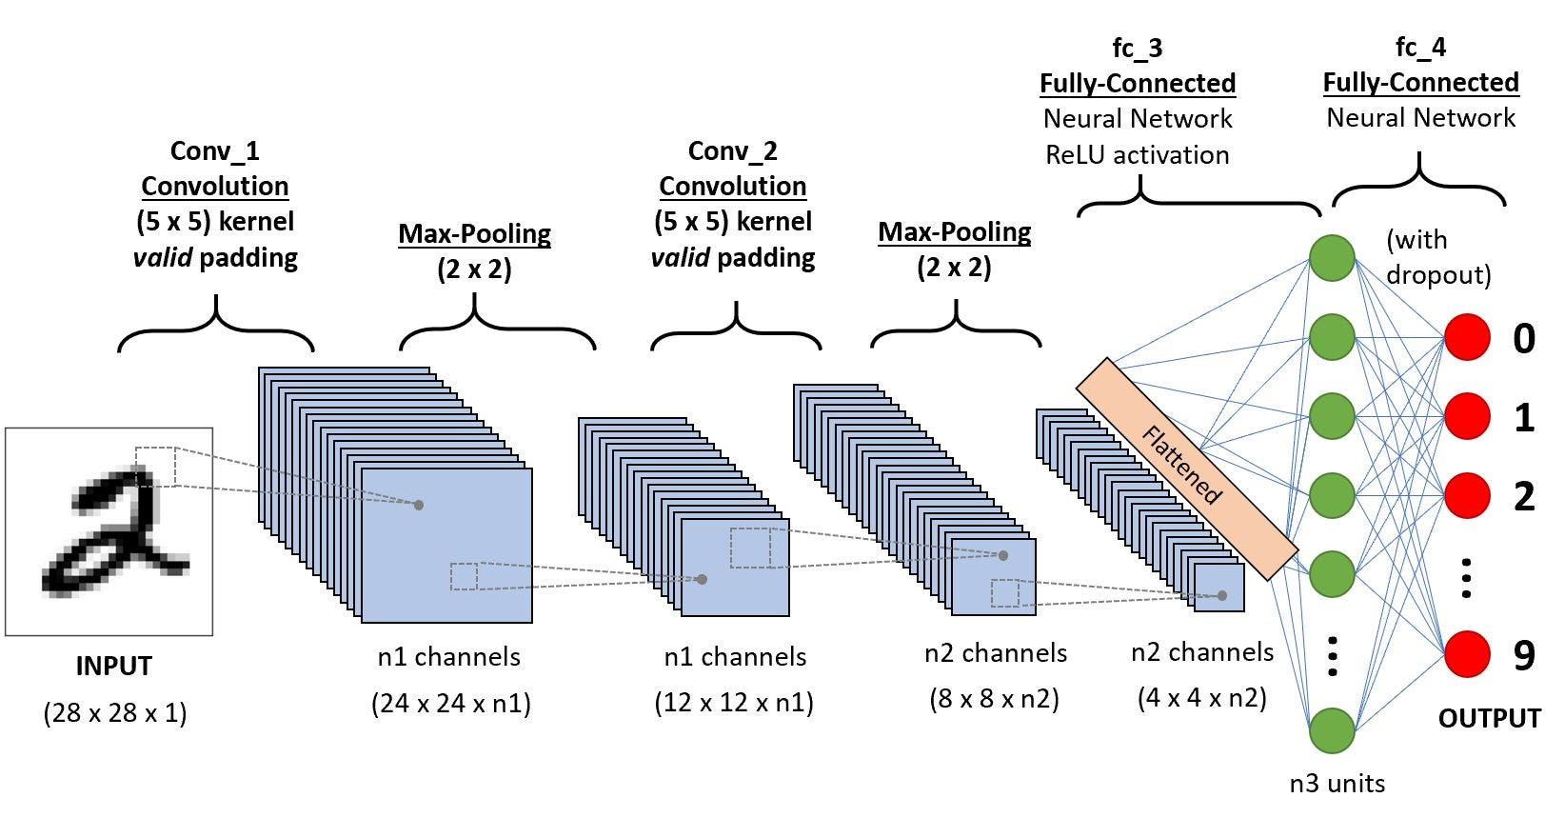
Improvements – CNN
State-of-the-art method
Accuracies of up to 99.80% possible
Our CNN: 99.08%
Reason: hierarchical feature extraction and end-to-end optimization

Slide 20
References
Grant, P. (2019). k-Nearest Neighbors and the Curse of Dimensionality. https://towardsdatascience.com/k-nearest-neighbors-and-the-curse-of-dimensionality-e39d10a6105d. accessed on: 11.07.2023
Haran, B. (2022). K-d Trees - Computerphile. https://www.youtube.com/watch?v=BK5x7IUTIyU. accessed on: 11.07.2023
Hucker, M. (2020). Tree algorithms explained: Ball Tree Algorithm vs. KD Tree vs. Brute Force.
Meigarom (2017). Dimensionality Reduction — Does PCA really improve classification outcome? https://towardsdatascience.com/dimensionality-reduction-does-pca-really-improve-classification-outcome-6e9ba21f0a32. accessed on: 12.07.2023
Géron, A. (2022). Hands-on machine learning with Scikit-Learn, Keras, and TensorFlow. O'Reilly Media, Inc.
Kanstrén, T. (2020). A Look at Precision, Recall, and F1-Score. https://towardsdatascience.com/a-look-at-precision-recall-and-f1-score-36b5fd0dd3ec. accessed on: 11.07.2023
Kasperek, D., Podpora, M., and Kawala-Sterniuk, A. (2022). Comparison of the Usability of Apple M1 Processors for Various Machine Learning Tasks. Sensors 22, 8005.
Klein, B. NumPy Tutorial. https://www.python-kurs.eu/numpy.php. accessed on: 07.07.2023
LeCun, Y., Bengio, Y., and Hinton, G. (2015). Deep learning. Nature 521, 436-444. 10.1038/nature14539.
scikit-learn. sklearn.neighbors.KNeighborsClassifier. https://scikit-learn.org/stable/modules/generated/sklearn.neighbors.KNeighborsClassifier.html. accessed on: 13.07.2023

Slide 21
Additional Slides

Slide 22
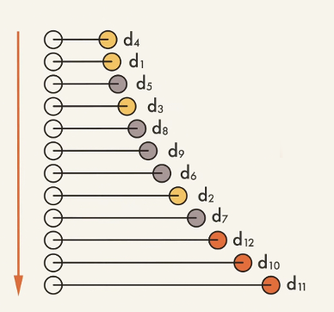
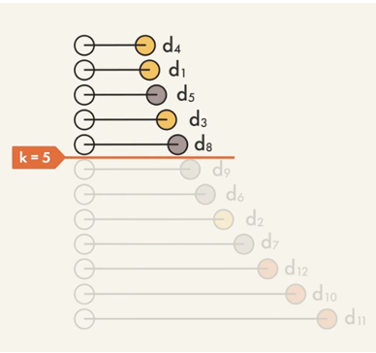
K-Nearest Neighbors
Calculating euclidean distance between test data point and train data points
Sort distances in ascending order
Select top k-rows
Majority vote
Calculate accuracy

Slide 23
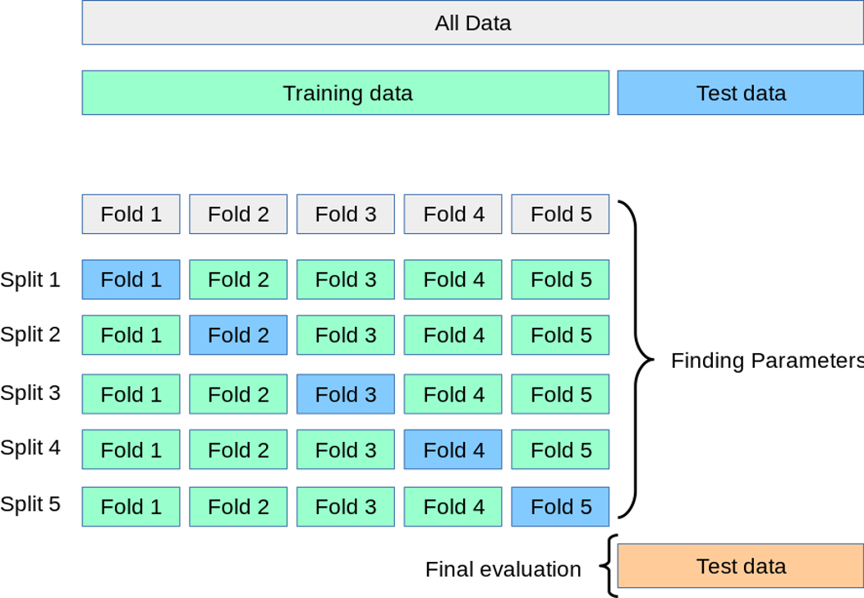
What could we have improved?
K-fold cross validation
Our Project:
1 train data set
1 test data set
Improvement:
Split of data sets
1 train data set
1 validation data set
1 test data set

